Slide 1
Understanding your
Paycheck

Slide 2
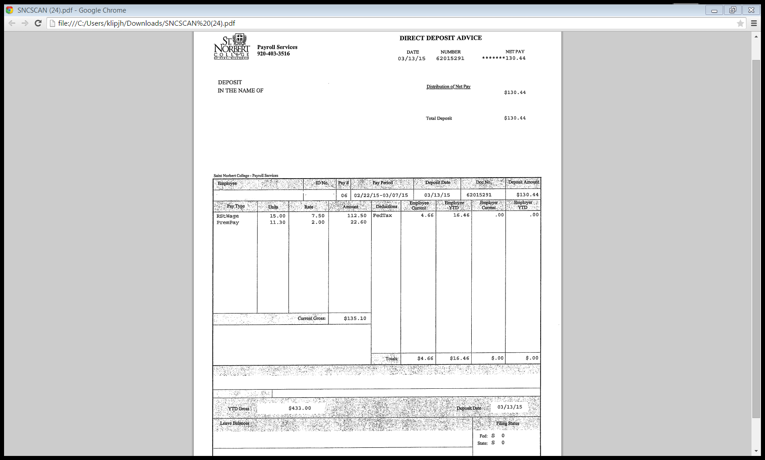
‘
Date: When it will be deposited at your bank
Deposit in the Name of:
Net Pay: Amount you earn after all deductions have been taken
Your Name
Employee Name & ID:
Your name & ID No
Distribution of Net pay: Bank Account where your money will be deposited
Pay Period: Start & End of Pay Period
Deposit Amount: Amount that will be deposited in your bank account
Deductions are money subtracted from gross pay
Federal & State tax are determined by information on your W-4.
FICA/Social Security tax provides retirement income for old-age, survivors & disability insurance (taxed at 6.2% of gross income)
Medicare provides health care programs for the elderly & disabled (taxed at 1.45% of gross income)
Both FICA & Medicare are matched by the employer
Current Gross: Amount of money earned before deductions are taken
YTD Gross: How much money you have made so far this year
**Note-If student, please see next page**

Slide 3
Federal Income Tax is funds services provided by the federal government (such as defense & human services)
State Income Tax is funds services provided by state government (such as roads, safety & health)
FICA/Social Security tax provides retirement income for old-age, survivors & disability insurance
(taxed at 6.2% of gross income)
Medicare provides health care programs for the elderly & disabled
(taxed at 1.45% of gross income)
Both FICA & Medicare are matched by the employer
*Students*
FICA/Social Security & Medicare taxes are not withheld while the student is working and attending college. If the student works at the college during the summer then FICA/Social Security & Medicare will be withheld.

