Slide 1
Your W-2
Why It Does Not Match Your Last Pay Statement of the Year

Slide 2
The W-2
The W-2 is an annual statement of wages and taxes provided to employees in order to file their personal Income Tax form.

Slide 3
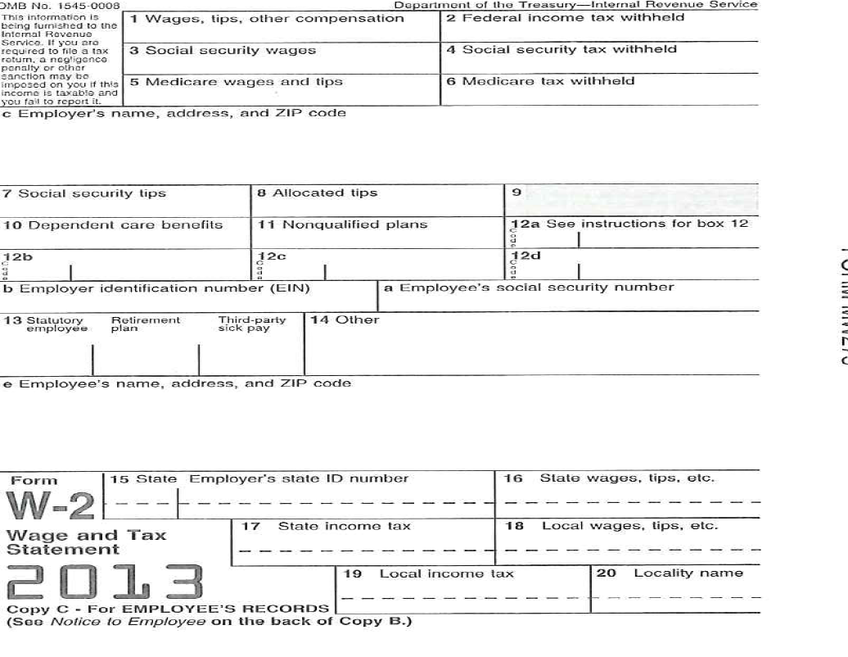
Pay Event Transactions
Action required by all approvers: | 0
Time or Leave Transactions Approved or FYI: | 821
Time or Leave Transactions Awaiting Approval or FYI: | 0
Total: | 821
Total Hours: | 11,792.28
Total Units: | .00

Slide 4
Box 1 – Wages, Tips, Other Compensation
At the bottom of your pay statement there is a gray line with a year-to-date (YTD) Gross box. Gross pay is not taxable wages, unless you have no pre-tax deductions.
Subtract the following deductions from the YTD gross on your final pay statement to calculate the amount of taxable wages appearing in Box 1. You may not have all of the following deductions from your wages. Be sure to subtract the year-to-date amounts.
TIAA Ret – your TIAA CREF retirement – employee YTD amount. Subtract all your TIAA CREF employee YTD amounts. (SRA Flat, SRA Percent, RA Add F, etc.)
Health – subtract the employee YTD health insurance deduction.
Dental – subtract the employee YTD dental insurance deduction.
Flex Med – subtract the employee YTD flexible medical spending deduction.
Flex Dep – subtract the employee YTD flexible dependent care deduction.
Non-taxable moving expenses – subtract the amount in Box 12c designated with the Letter P. (This is rare.)
Add the annual amount of Imputed Income for Life Insurance. The annual amount of Imputed Income for Life Insurance appears in Box 12 on your W-2 designated with the letter C. This is the amount you will need to add to calculate your taxable wages.
The imputed life insurance amount also appears at the very bottom of your pay statement. The amount on your pay statement is a monthly amount. This amount changes during the year based on your age and your wages.

Slide 5
Box 2 – Federal Income Tax Withheld
This is the amount of federal income tax withheld from your pay check during the calendar year. It should match – exactly – the amount of employee year-to-date (YTD) Fed Tax amount on your last direct deposit statement of the calendar year.

Slide 6
Box 3 – Social Security Wages
Total wages in Box 3 are the wages subject to social security (FICA) tax. These wages are taxed at 6.2% up to a limit determined each year by the federal government. For calendar year 2013, the maximum amount of taxable social security wages is $113,700. The amount of taxable social security wages is determined by subtracting the following from the year-to-date (YTD) gross wages on your last direct deposit statement.
Health – subtract the YTD employee health insurance deduction.
Dental – subtract the YTD employee dental insurance deduction.
Flex Med – subtract the YTD employee flexible medical spending deduction.
Flex Dep – subtract the YTD employee flexible dependent care deduction.
Non-taxable moving expense reimbursement – subtract the amount in Box 12c – Letter P.
Add the annual amount of Imputed Income for Life Insurance. The annual amount of Imputed Income for Life Insurance appears in Box 12 on your W-2 designated with the letter C. This is the amount you will need to add to calculate your taxable wages.
The imputed life insurance amount also appears at the very bottom of your pay statement. The amount on your pay statement is a monthly amount. This amount changes during the year based on your age and your wages.
Social Security Wages may also be calculated by taking the amount in Box 1 and ADDING all of your TIAA-CREF retirement deductions. TIAA-CREF is not taxable for federal income tax, however, it is taxable for social security (FICA) tax.

Slide 7
Box 4 – Social Security Tax Withheld
This is the amount of social security tax withheld from your wages during the calendar year. It should match – exactly – the employee year-to-date (YTD) FICA amount on your last pay statement of the calendar year.
It should also be 6.2% of the amount in Box 3 on your W-2.

Slide 8
Box 5 – Medicare Wages and Tips
Total wages in Box 5 are the wages subject to Medicare (Medic) tax. These wages are taxed at 1.45% and there is no limit on the taxable amount of wages. The amount of taxable Medicare wages is determined by subtracting the following from the year-to-date (YTD) gross wages on your last pay statement.
Health – subtract the YTD employee health insurance deduction.
Dental – subtract the YTD employee dental insurance deduction.
Flex Med – subtract the YTD employee flexible medical spending deduction.
Flex Dep – subtract the YTD employee flexible dependent care deduction.
Non-taxable moving expense reimbursement – subtract the amount in Box 12c – Letter P.
Add the annual amount of Imputed Income for Life Insurance. The annual amount of Imputed Income for Life Insurance appears in Box 12 on your W-2 designated with the letter C. This is the amount you will need to add to calculate your taxable wages.
The imputed life insurance amount also appears at the very bottom of your pay statement. The amount on your pay statement is a monthly amount. This amount changes during the year based on your age and your wages.
Medicare Wages and Tips may also be calculated by taking the amount in Box 1 and ADDING all of your TIAA-CREF retirement deductions. Retirement contributions are not taxable for federal income tax, however, they are taxable for Medicare (Medic) tax.

Slide 9
Box 6 – Medicare Tax Withheld
This is the amount of Medicare tax withheld from your wages during the calendar year. It should match – exactly – the employee year-to-date (YTD) Medicare (Medic) amount on your last pay statement of the calendar year.
It should also be 1.45% of the amount in Box 5 on your W-2.

Slide 10
Box 10 – Dependent Care Benefits
This is an informational box for the Internal Revenue Service. The amount in Box 10 should match – exactly – the year-to-date deduction for flexible dependent care (Flex Dep) on your last direct deposit statement for the calendar year. The total dependent care deduction is not included in your total wages in Box 1, Box 3, or Box 5. Dependent care is a “pre-tax” deduction and is deducted from taxable wages.

Slide 11
Box 12a – Letter C
Box 12 a – designated with the letter C is imputed life insurance. Imputed life insurance is the taxable value assigned to the College life insurance benefit which exceeds $50,000. The imputed life insurance calculation is based on an Internal Revenue Service formula combining the amount and your age. The calculation may be found on the Internal Revenue website listed below:
http://www.irs.gov/pub/irs-pdf/p15b.pdf

Slide 12
Box 12b – Letter E
Box 12b – designated with the letter E is the total of your retirement deductions for the calendar year. This should match – EXACTLY – the year-to-date employee retirement deductions on your last pay statement of the calendar year.
Add the number in Box 12b designated with the Letter E to the number in Box 1 and it should equal the number in Box 5 of your W-2.

Slide 13
Box 12c
Box 12c may be used for a number of other income items, the most relevant are listed below:
Letter P – Excludable moving expense reimbursements paid directly to employee
Letter DD – Cost of employer-sponsored health coverage (not currently used)

Slide 14
State Income Information
Box 15 indicates the state your income has been reported to.
Box 16 is your total state income. This should match EXACTLY to the amount in Box 1 on your W-2.
Box 17 is the total of your state withholding tax and should match EXACTLY to your state income tax withholding on your last pay statement of the calendar year.

